Slide 1

Final ProjectReal time stream processing using
Kafka and Storm
Rangarajan, Deeptha kannan
csci e63 Big Data Analytics, 2014
Harvard Extension School
Professor: Zoran B. Djordjević
Deeptha kannan Rangarajan
*
Notes:
*

Slide 2
Hadoop is great, but is it enough?
Hadoop solves the static-big-data problem
What about real-time data?
*

Slide 3
Apache Storm
A distributed real-time computation system for processing fast, large streams of data
Created by Nathan Marz and team at BackType
Acquired by Twitter
Open sourced in 2011
Written in Clojure and Java
Fast – benchmarked as processing one million 100 byte messages per second per node
Storm easily integrates with any queueing system and any database system
*

Slide 4
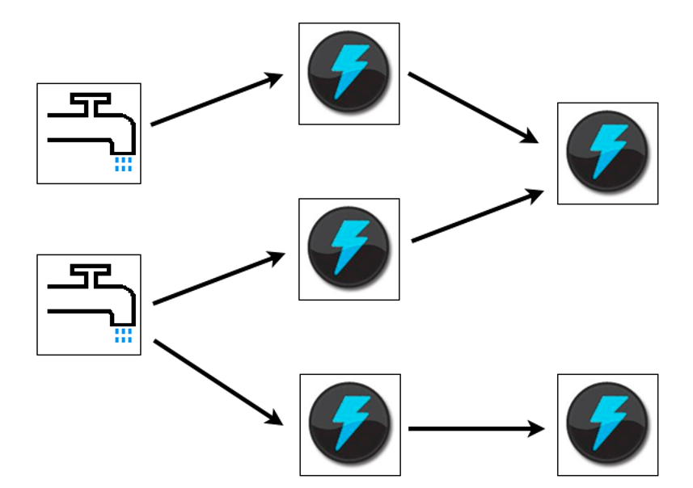
Apache Storm - Features
Allocation of work across nodes
Guaranteed message processing
Fault-tolerant
Scalability
Performance
Simple to program
*

Slide 5
Apache Storm - Components
Nimbus node (master node, similar to the Hadoop JobTracker):
Distributes code across the cluster
Launches workers across the cluster
Monitors computation and reallocates workers as needed
ZooKeeper nodes – coordinates the Storm cluster
Supervisor nodes – communicates with Nimbus through Zookeeper, starts and stops workers according to signals from Nimbus

Slide 6
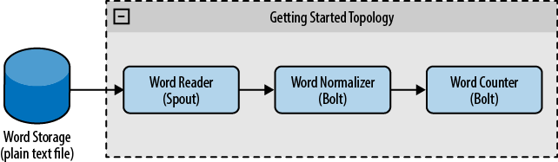
Apache Storm - Terminology
The input stream of a Storm cluster is handled by a spout.
The spout passes the data to a component called a bolt, which after processing, either persists the data in some sort of storage, or passes it to some other bolt.
The arrangement of all the components (spouts and bolts) and their connections is called a topology
*

Slide 7
Apache Storm - Stream Grouping
A Stream Grouping specifies which stream(s) are consumed by each bolt and
how the stream will be consumed.
Types
Shuffle Grouping - Most common
Fields Grouping
All Grouping
Custom Grouping
Direct Grouping - Source Decides which component will receive message
Global Grouping - Send all tuples to one bolt instance

Slide 8
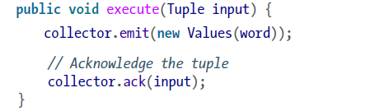
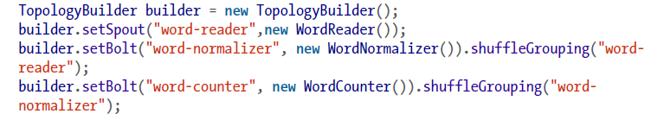
Apache Storm - Is it really simple?
Spout - IRichSpout
…….
Bolt - IRichBolt
Create Topology and Run
Local mode - LocalCluster
Remote mode - StormSubmitter

Slide 9
Apache Kafka
A publish-subscribe messaging rethought as a distributed commit log
Aims to provide a high-throughput, low-latency platform for handling real-time feed
Developed in Linkedin to track user activities
Open sourced in 2011
Written in Scala and Java
FAST - A single Kafka broker can handle hundreds of megabytes of reads and writes per second from thousands of clients.
*

Slide 10
Apache Kafka - Features
Durability
Messages are persisted on disk and replicated within the cluster to prevent data loss
Scalability
It can be elastically and transparently expanded without downtime
Fault-tolerant
Reelection of Partition leader when a node goes down
Performance
Smart approach when writing data to disk
*

Slide 11
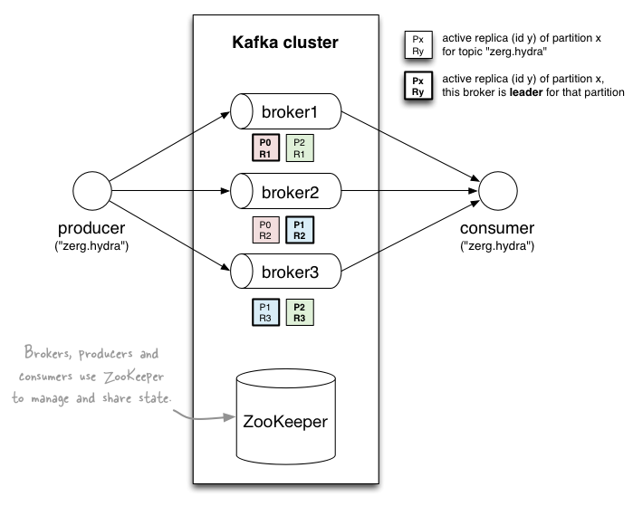
Apache Kafka - Terminology
Topics
Partitions
Brokers
Producer
Consumer
*

Slide 12
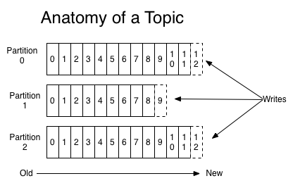
Apache Kafka - Topics and Partitions
*

Slide 13
Apache Kafka - Producers
Producers need to know one broker at least to query for partitions
Producers send messages with topic and a key (key is optional)
Key is used to decide which partition to publish to
Custom partitioner helps to have more control
Default partitioner user mod computation on your key to identify partition
If you key is null, message is assigned to a random partition

Slide 14
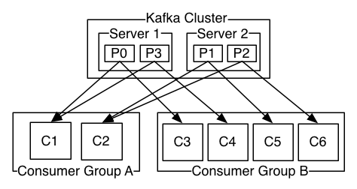
Apache Kafka - Consumers
Two consumer APIs provided by kafka to PULL data out of Brokers
High level consumer
Simple consumer

Slide 15
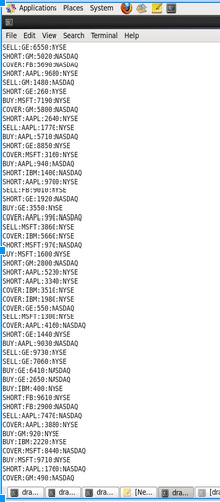
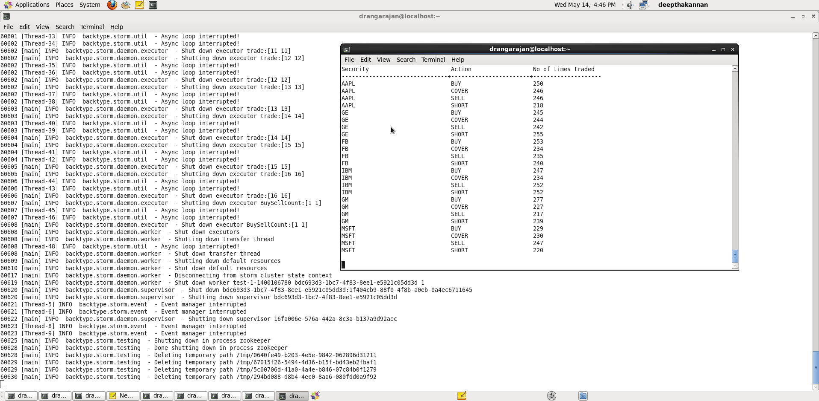
Kafka and Storm Demo
Kafka producer simulating Output of Trade Information aggregation
trade information
For more information, please watch,
https://www.youtube.com/watch?v=TrsIHE-cVjc

Slide 16
References
Storm,
https://github.com/nathanmarz/storm
http://hortonworks.com/hadoop/storm/
https://twitter.com/stormprocessor
http://storm.incubator.apache.org/
Book -> Getting Started with Storm by Jonathan Leibiusky, Gabriel Eisbruch, Dario Simonassi
Kafka,
http://www.michael-noll.com/blog/2013/03/13/running-a-multi-broker-apache-kafka-cluster-on-a-single-node/
https://kafka.apache.org
http://blog.linkedin.com/
http://www.slideshare.net/
For Cassandra drivers and usage,
http://www.datastax.com/

